Slide 1
MAXIMIZING FOOTBALL PLAYER MARKET VALUE WITH MACHINE LEARNING
TEAM 12
Source: Unsplash https://unsplash.com/photos/timelapse-photo-of-soccer-player-kicking-ball-cuhQcfp3By4

Slide 2
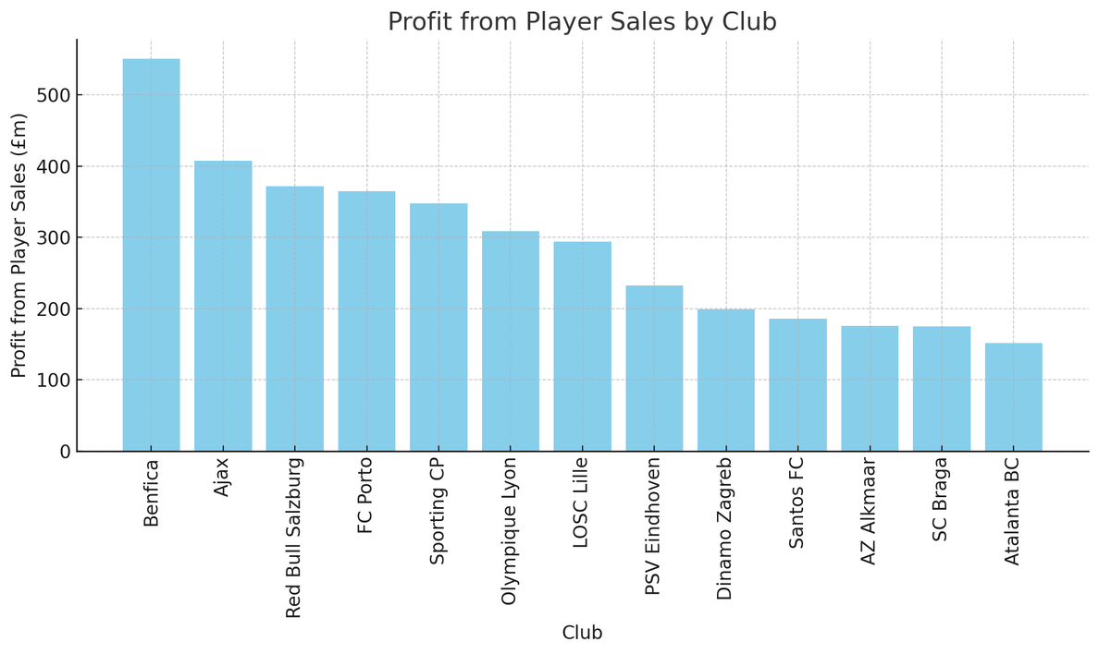


Selling Clubs
Invest In Player Development
(Re)Invest In Player Development
Sell Player At A
High Value
Pocket Profit
Source: Givemesport https://www.givemesport.com/ranking-clubs-made-the-most-money-in-the-transfer-window-last-10-years/

Slide 3

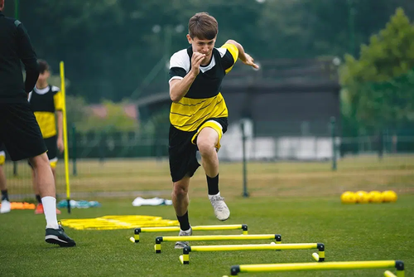


Business Problem
Which Trainable Player Attributes have the greatest impact on market value
Which players are being overvalued
How to accurately assess rising stars’ value
Source: https://www.isspf.com/articles/the-importance-of-strength-training-in-soccer/
https://www.skysports.com/football/news/11095/13206129/jadon-sancho-chelsea-make-deadline-day-loan-signing-of-manchester-united-forward
https://www.theguardian.com/football/2023/nov/02/evan-ferguson-rapid-rise-bohemians-to-brighton

Slide 4
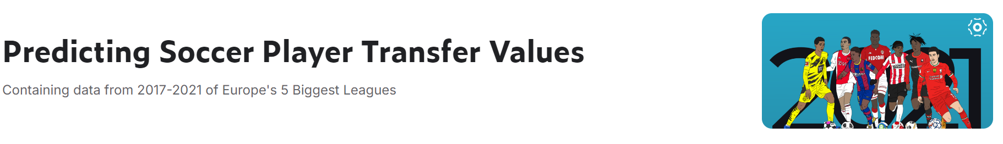
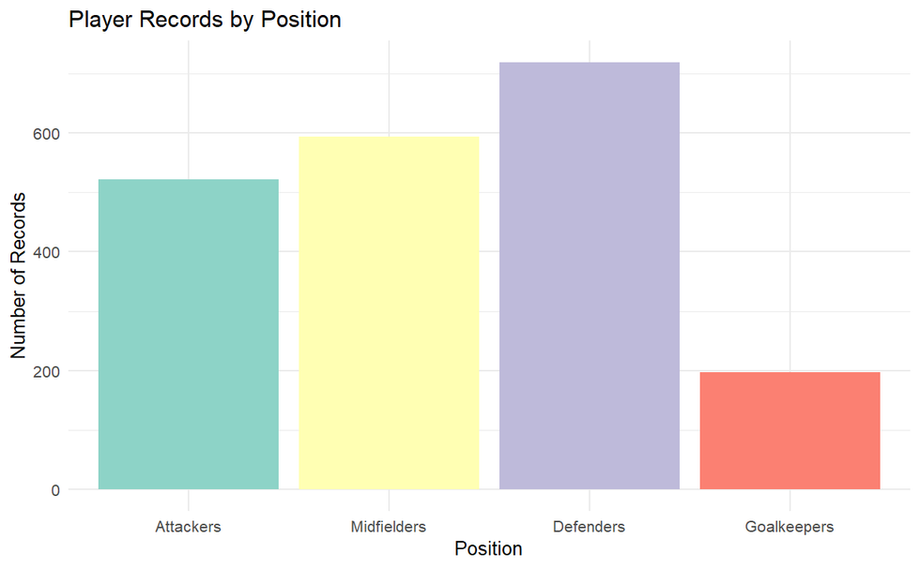
DATA SUMMARY
2061
Player Entries
4
Seasons
17/18 - 20/21
TOP 5
European Leagues
134
Player
Attributes
Source: https://www.kaggle.com/datasets/sanjitva/predicting-soccer-player-transfer-values

Slide 5
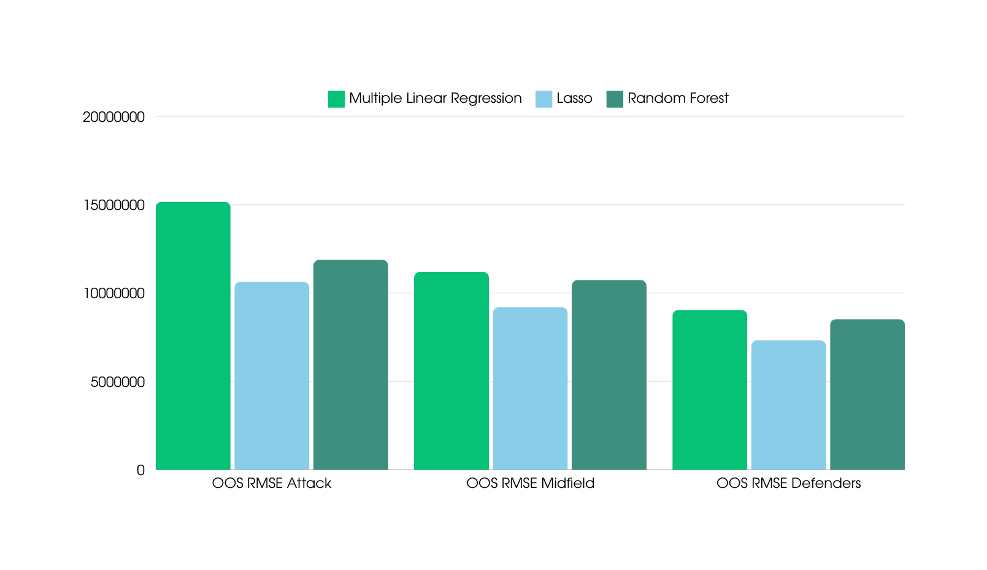
MODEL PERFORMANCE

Slide 6

KEY ATTRIBUTES FOR ATTACKERS
Metric | Value
xG/90_Weighted_Avg | 4746817.8166
xGandxA/90_Weighted_Avg | 4361853.3317
Non-PenaltyGoals_Weighted_Avg | 821964.8579
Gls_Weighted_Avg | 365048.1532
PenaltyKicksWon_Weighted_Avg | 307959.2912
RedCards_Weighted_Avg | 300023.2651
Non-PenaltyxGandxA/90_Weighted_Avg | 245634.5094
CarriesintoAttackingPenaltyBox_Weighted_Avg | 231470.4638
TouchesinAttackingPenaltyBox_Weighted_Avg | 19405.0714
AerialDuelLost_Weighted_Avg | -7771.5092

Slide 7
STRATEGIC COACHING FOCUS FOR ATTACKERS
ENHANCE SCORING PROFICIENCY:
DEVELOP GOAL-SCORING OPPORTUNITIES:
MAXIMIZE TACTICAL AWARENESS:
Focus on improving Expected Goals (xG/90), Non-Penalty Goals, and Penalty Kicks Won through targeted drills.
Implement finishing drills, one-on-one scenarios, and quick passing combinations to increase offensive effectiveness.
Encourage players to improve their positioning and decision-making to exploit defensive gaps and create scoring chances.
Tactical understanding is crucial to performing well in soccer.

Slide 8
KEY ATTRIBUTES FOR MIDFIELDERS
Metric | Value
xA/90_Weighted_Avg | 16219976.9551
Gls_Weighted_Avg | 579714.0180
Ast_Weighted_Avg | 557739.8789
PenaltiesConceded_Weighted_Avg | 1345268.0213
FoulsDrawnLeadingtoGoals_Weighted_Avg | 547911.6464
TotalAssists_Weighted_Avg | 499201.0969
PassesLeadingtoGoals_Weighted_Avg | 441224.4999
ShotsonTarget/90_Weighted_Avg | 369000.9080
xG_Weighted_Avg | 349414.4869

Slide 9
STRATEGIC COACHING FOCUS FOR MIDFIELDERS
ENHANCE CHANCE CREATION SKILLS:
IMPLEMENT GOAL-CREATING DRILLS:
LEVERAGE COMPETITIVE OPPORTUNITIES:
Focus on developing expected assists per 90 minutes (xA/90) and passes leading to goals to boost midfielders' value.
Prioritize training that emphasizes goal-creating actions to improve overall performance and marketability.
Consider loaning players to top leagues, like the Premier League, to elevate their market value and visibility.
Tactical understanding is crucial to performing well in soccer.

Slide 10
KEY ATTRIBUTES FOR DEFENDERS
Metric | Overall
NumberofTimesReceivedPass_Weighted_Avg | 100.000000
NumberofTimesPlayerwasPassTarget_Weighted_Avg | 96.040040
PassesCompleted-Allpass-types_Weighted_Avg | 36.084686
TotalCarries_Weighted_Avg | 26.372652
TotalDistanceCarriedtheBall_Weighted_Avg | 22.661878
TouchesinMidfield3rd_Weighted_Avg | 11.207714
ShotsLeadingtoGoals_Weighted_Avg | 11.111466
%AerialDuelsWon_Weighted_Avg | 10.120521
PassCompletion%-Allpass-types_Weighted_Avg | 8.960492

Slide 11
STRATEGIC COACHING FOCUS FOR DEFENDERS
FOCUS ON KEY ATTRIBUTES:
EMPHASIZE POSITIONING AND DECISION-MAKING:
IMPLEMENT GAME-RELATED DRILLS:
Enhance defenders' value by improving their received passes, total carries, and touches in midfield.
Prioritize training that sharpens defenders' tactical awareness and technical skills for ball-playing.
Utilize small-sided games and passing drills under pressure to boost effectiveness in real match situations.
Tactical understanding is crucial to performing well in soccer.

Slide 12
MAXIMIZING PLAYER VALUE WITH DATA-DRIVEN INSIGHTS
ACCURATE MARKET VALUATION:
INFORMED NEGOTIATIONS:
MAXIMIZING ROI:
Use the data-driven model to establish a more precise market value for players, such as Leandro Trossard, predicted at €19,394,226 compared to his current valuation of €15,300,000.
Leverage accurate predictions to set appropriate asking prices when engaging with larger clubs, enhancing the club's bargaining position.
By confidently negotiating higher transfer fees based on data insights, clubs can maximize their ROI on player sales.
Tactical understanding is crucial to performing well in soccer.

Slide 13

INSIGHTS FOR CLUBS
DATA-DRIVEN DECISION MAKING:
ENHANCED TRANSFER NEGOTIATIONS:
Utilize machine learning models to identify key player attributes that drive market value, enabling clubs to tailor training programs and improve player performance strategically.
Predict players' market values more accurately, allowing clubs to set competitive asking prices and negotiate better transfer deals based on data-driven insights.

Slide 14
THANK YOU

